Slide 1
Year 5 Parental Information

Slide 2
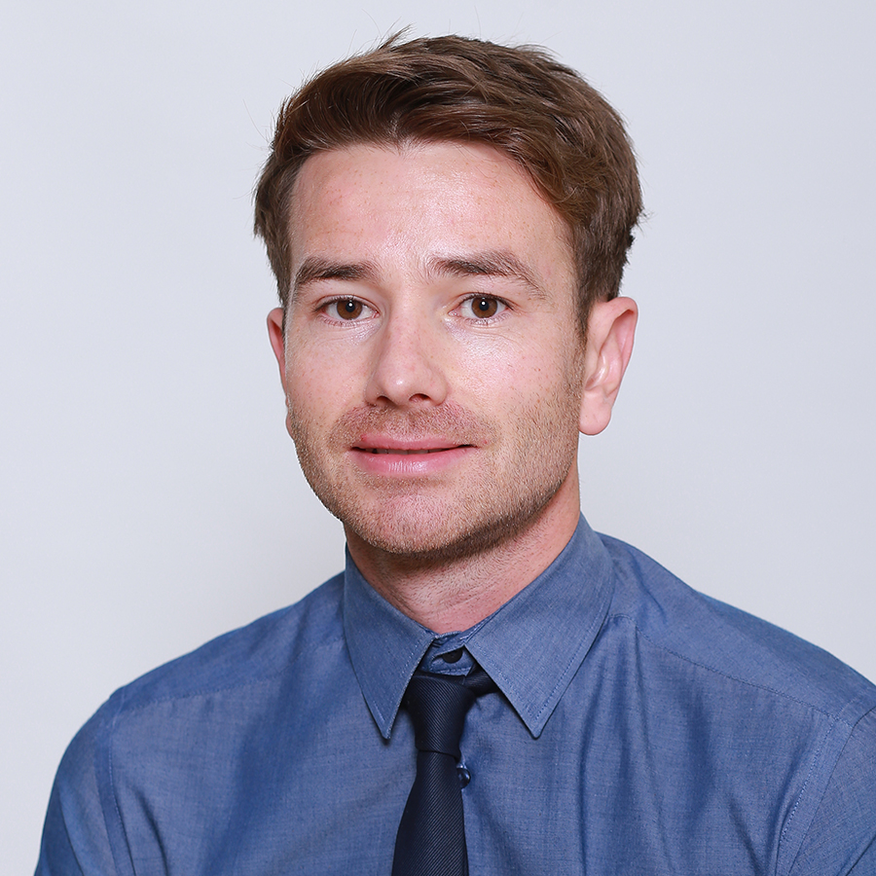
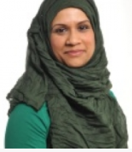
Year 5 Teaching Team
Mr P Quigley - Class Teacher
Ms N Khanom - Teaching Assistant

Slide 3
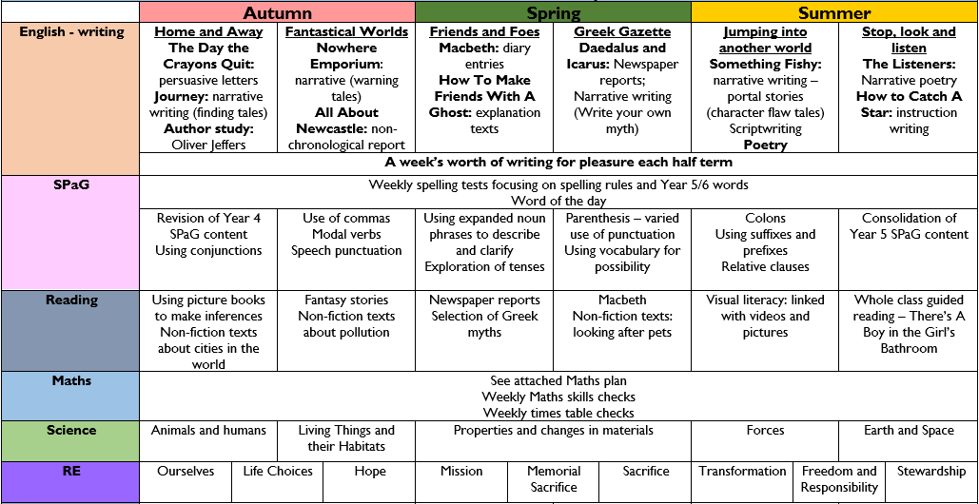
Year 5 core subject, learning topics

Slide 4
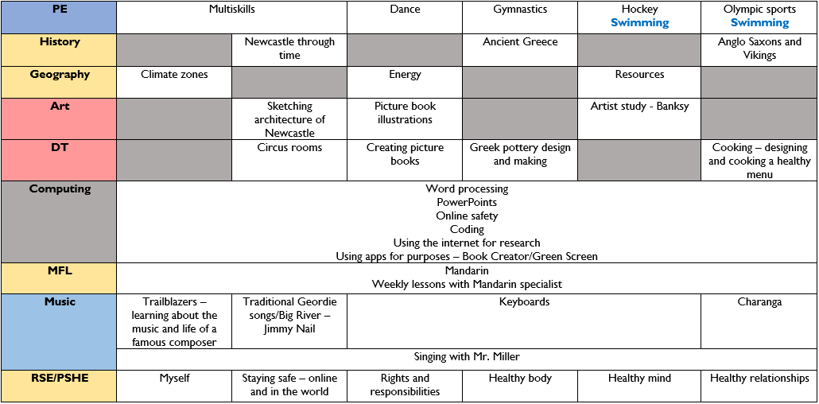
Year 5 foundation subjects, learning topics

Slide 5
Keeping up to date with your child’s progress
Please ensure that you keep up to date with your child’s progress on Parenthub. Parenthub will be the school’s primary source of contact to comply with the government’s current Covid-19 guidance.
If you need additional information or support with your child’s learning journey please use the emails below:
School administration contact:
Ourladyadmin@olsa.org.uk
Class teacher contact:
yr5@olsa.org.uk
*Unfortunately, staff have severely limited time and capacity to meet on a face-to-face basis in the mornings and afternoon at the school gate but if you would like an appointment to talk at length, please contact the school’s administration team.

Slide 6
Homework and Support at home.
Children are encouraged to consolidate and embed their learning at home on a daily basis to help them make age-related progress.
User credentials have been issued to support your child with the following learning platforms online:

Slide 7
Mathematics
MyMaths – A weekly learning activity will be released on a Friday for completion on the following Thursday.
Abacus- A range of games are available to embed previously learned concepts and strategies with a fun and engaging interface.
Times Tables Rock Stars- An interactive multiplication game designed to encourage children to develop a rapid recall of multiplication tables.
*By the end of year 4, children are expected to be able to recall multiplication and division facts for multiplication tables up to 12 × 12

Slide 8
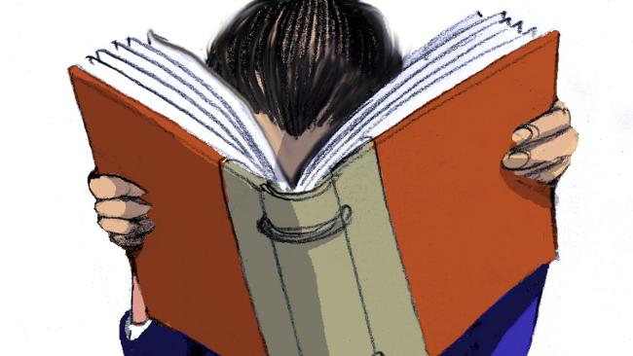
Reading
Reading Eggs provides children with engaging texts and helps children grasp a stronger understanding with carefully sequenced activities and games.
Lexia reading program offers additional reading opportunities and provides teachers with data and statistics on children’s development and progress in reading to inform their next steps.
Children will continue to read designated books to refine their reading skills, and will also be allocated a book, to read for pleasure, throughout the school day. Books will not go home to comply with Covid-19 guidance.

Slide 9
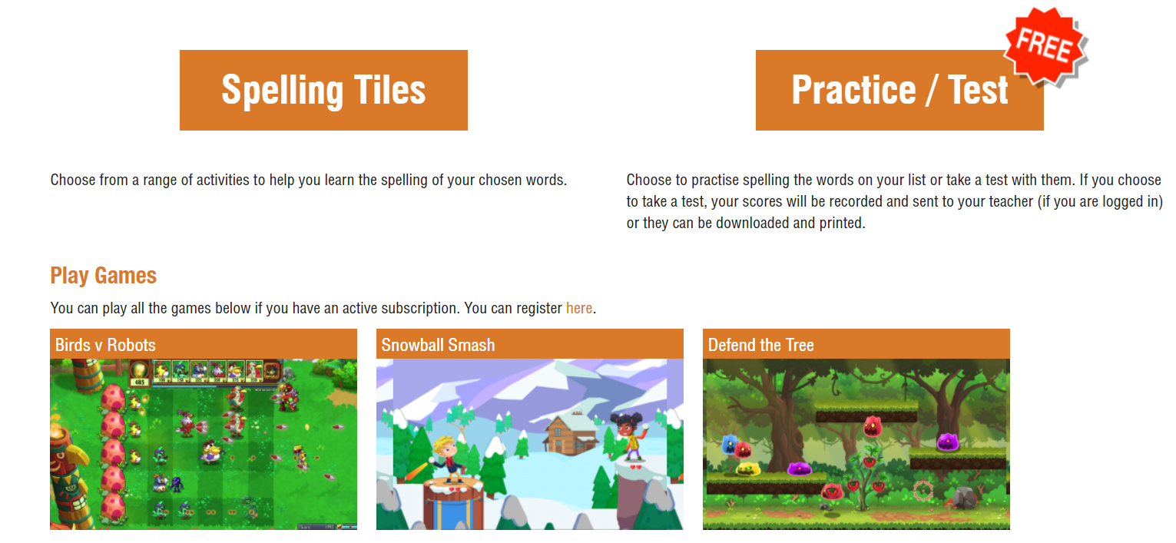
Spelling
Children will be challenged to spell ten spellings from the half termly spelling overview on a Friday morning with the aim of increasing the accuracy and fluency of writing and spelling and to expand their knowledge of vocabulary.
Supporting spelling at home
Please encourage your child to visit Year 5 spelling games and activities on Spelling Frame: https://spellingframe.co.uk/

Slide 10
A recommended schedule for homework
Monday | Tuesday | Wednesday | Thursday | Friday
10m Times Tables Rock Stars | 20m Writing for pleasure | 10m Reading | 10m Spelling Frame | 10m Abacus
10m Abacus | 15m Times Tables Rock Stars | 20m Writing for pleasure | 10m Reading | 10m Spelling Frame
10m Spelling Frame | 10m Abacus | 15m Times Tables Rock Stars | 20m Writing for pleasure | 10m Reading
10m Reading | 10m Spelling Frame | 10m Abacus | 15m Times Tables Rock Stars | 20m Writing for pleasure
20m Writing for pleasure | 10m Reading | 10m Spelling Frame | 10m Abacus | 15m Times Tables Rock Stars

Slide 11
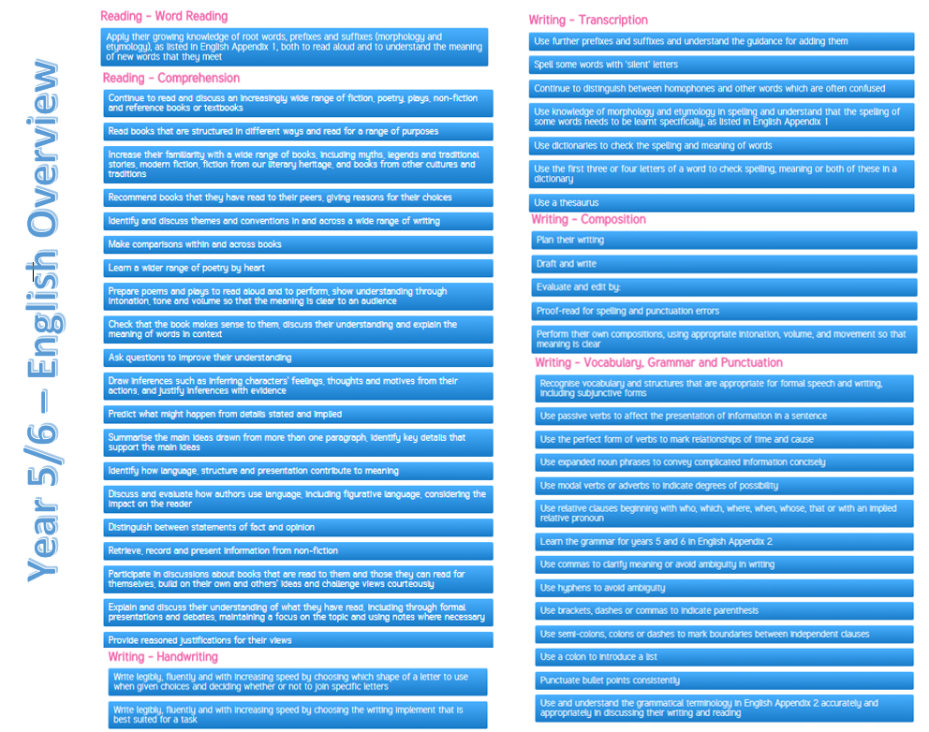
Year 5 Spelling Punctuation and Grammar

Slide 12
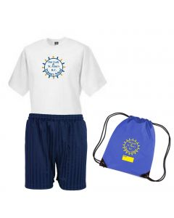
Physical Education and Uniform
Physical education will take place on Wednesdays. Children’s
lessons will take place both indoors and outdoors (weather permitting) so please ensure your child has appropriate clothing and footwear.
Children should a white t-shirt with the school’s logo and navy shorts/pants.
Throughout the week, children will also take place in short physical educational activities to accelerate their progress and also to promote PSHE.

Slide 13
Thank you for your continued support.

