Slide 1
Tapestry
Our Lady and St Annes RC Primary School
Nursery and Reception Class 2017-2018

Slide 2
How to find Tapestry.
You can use Tapestry by using your internet browser or by downloading the app to your phone or tablet.
To use it on your internet browser follow the link sent to you by the school or
Go to: www.tapestryjournal.com

Slide 3
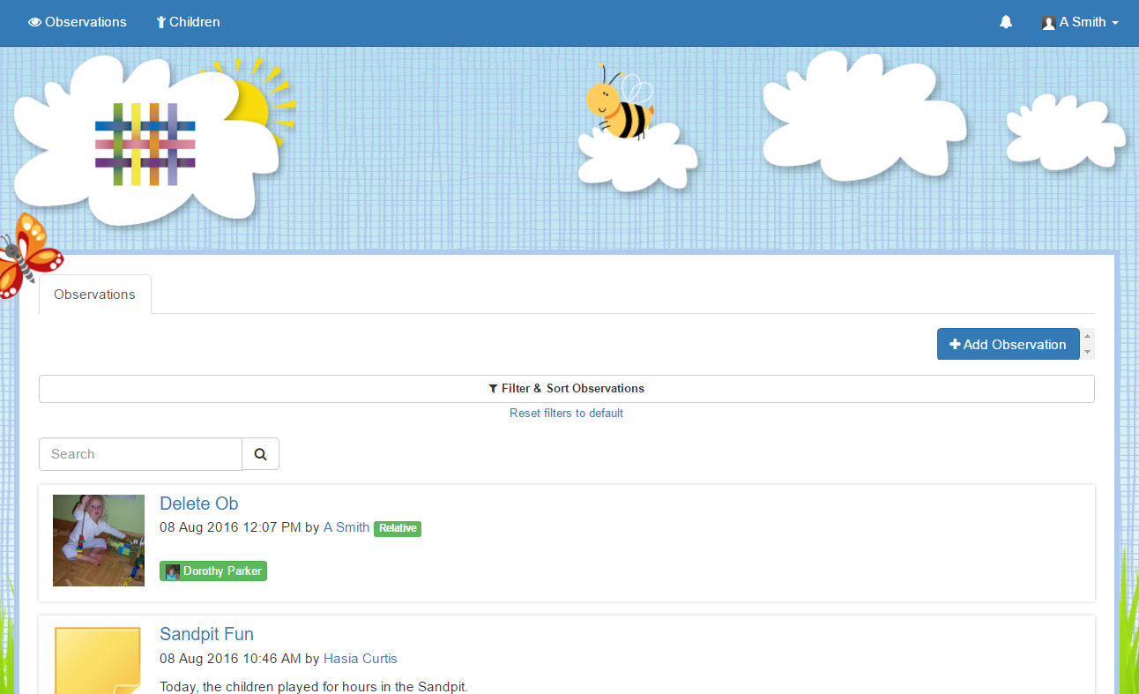
Once you have logged in. You will be taken to the home page. Here you will be able to see your child's observations in chronological order.
This list will grow throughout your child's time at their Setting.

Slide 4
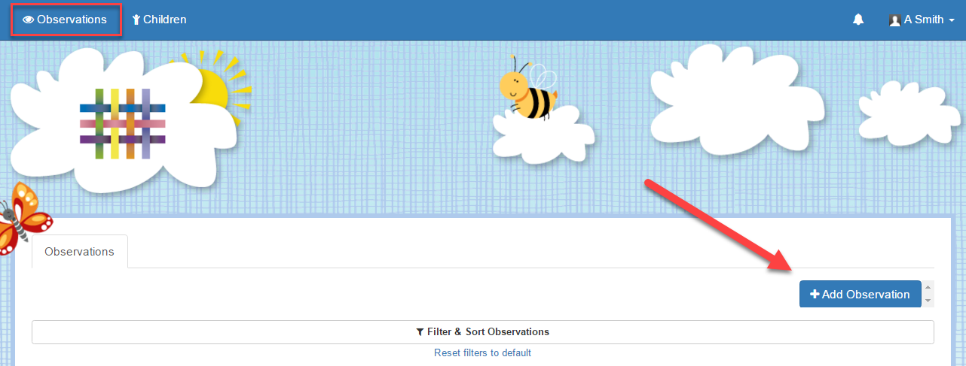
How to add an observation.
In order to add an observation, you first need to click on the blue 'Add Observation' button.
This can be found on the home 'Observations' tab

Slide 5
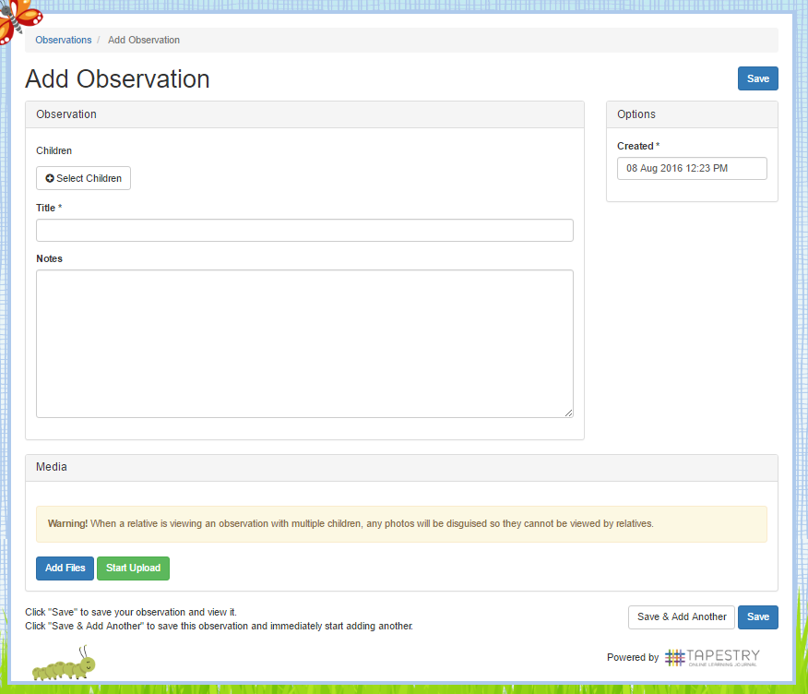
Once you have clicked on it, you will be taken to the page shown to the right. Here you will need to pick your child/children from the drop down list, add a title, and then you can add some notes and media.
Don't forget to press 'Save' at the end!
And that’s it! You can now view and add your own observations whenever you like.

Slide 6
How to connect to the Tapestry app.
Download the Tapestry app for free. It is available for smart and android devices. (Phone or tablet)
The next time you log in you will be asked to enter a PIN number. This will be quicker and more efficient when logging on.
Login using your email address and password.

Slide 7
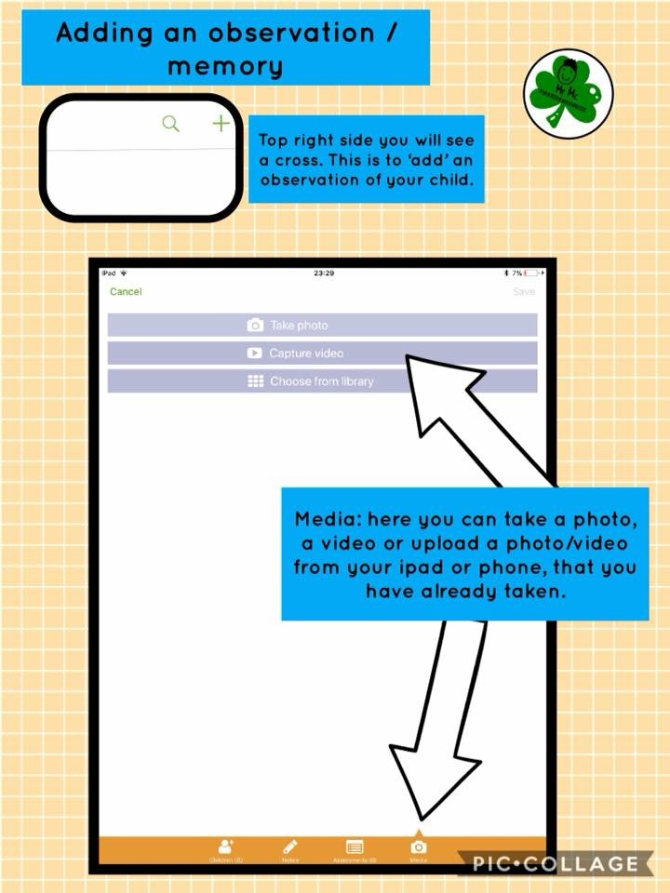
Adding an observation.
On the top right hand side you will see a cross. This is for you to ‘add’ an observation for your child.

Slide 8
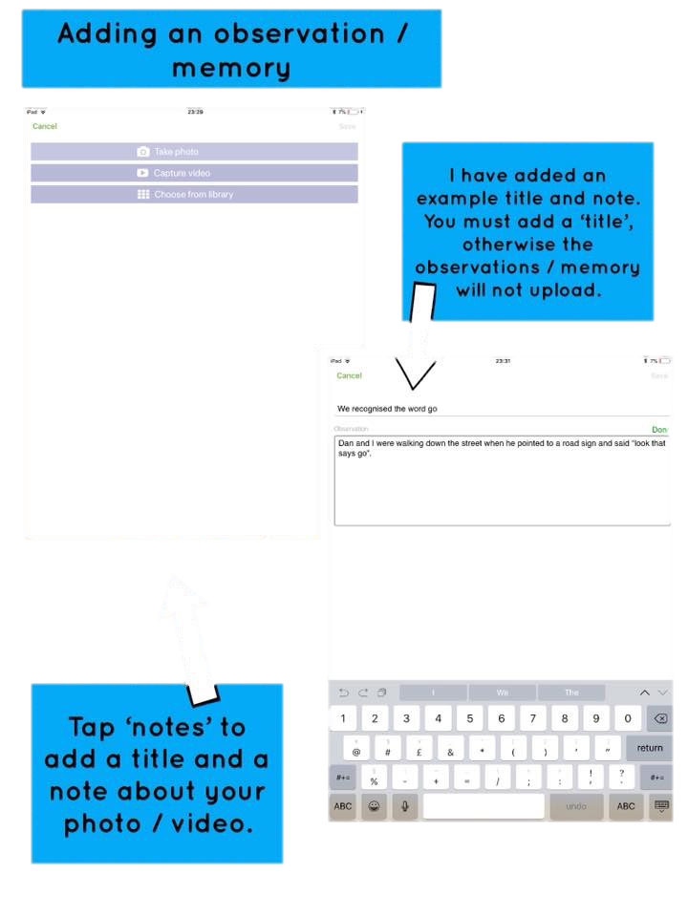

Slide 9
