Slide 1
Reading with your child
Guide for parents

Slide 2
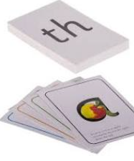
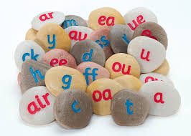
Phonics
Phonics learning relies on children being able to hear and distinguish the sounds in words.
We use Read Write Inc phonics scheme in school.
The first sounds (set 1) are single letter sounds and then the children are introduced to sounds represented by two letters (digraphs/special friends) e.g. th, sh, ck, ch. The children then learn to blend the sounds together to read words.
The children also learn to read ‘red/tricky’ words which cannot be read phonetically e.g. the, said, you.
The children then learn more digraphs (set 2/ set 3) such as ay, ee, igh, air, oo. As well as split sounds a-e in cake and i-e in nice.
The children developing confidence in spotting and reading these sounds in words and then using them in their writing.

Slide 3
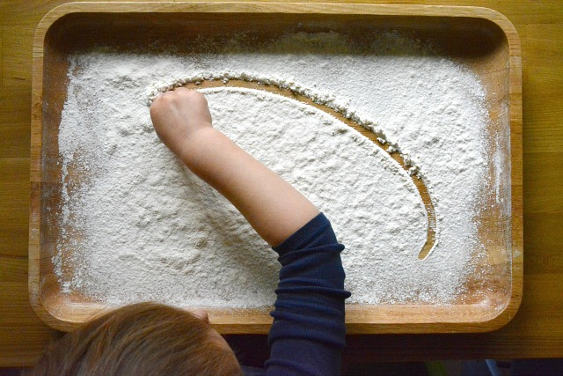
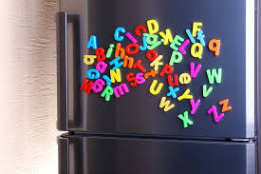
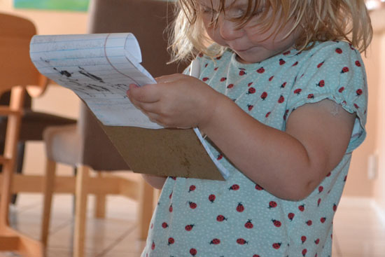
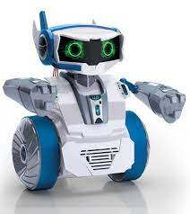
Early Reading Tips
Flour writing – use a baking tray to form letters.
Making lists together. Can child read/write simple words.
Using magnet letters on the fridge.
Talking like robots – Can you find your s-o-ck-s?
I spy – Can you spot something with m or when out and about asking your child to spot letters.

Slide 4
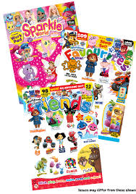
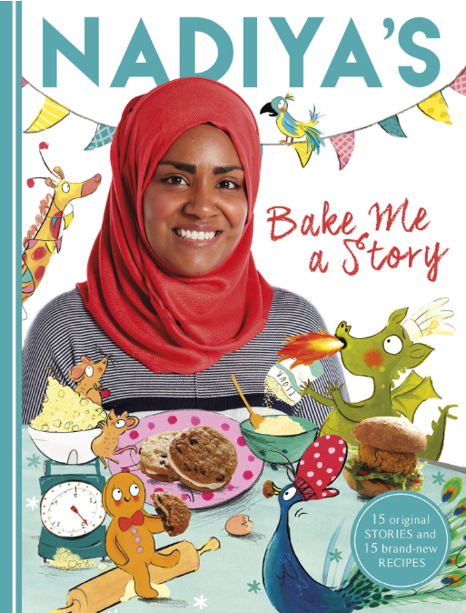
Developing a love of reading
Reading should be a positive experience. So never force your child to read.
We want every children to develop a love of reading.
If your child is reluctant to read, read to them.
When they do read lots of praise and encouragement.
By reading to your child you model clear, fluent reading and how to use expression.
Read a range of different texts – picture books, information texts, nursery rhymes, recipes, instructions, shop signs, road signs, leaflets .

Slide 5
Reading with your child
Pretend that you are struggling to read a word. Model ways to tackle it, looking for sounds(special friends), sounding it out, looking for clues in the pictures. Ask your child to help you.
Show your child how to find answers rather than answering questions or reading words for them.
Point out punctuation. Explain what different marks mean.
Ask for your child’s opinion. Did you like this story? Did you learn anything new? What types of books do you enjoy reading?

Slide 6
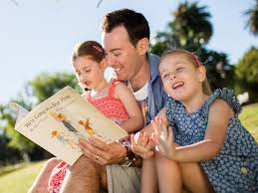
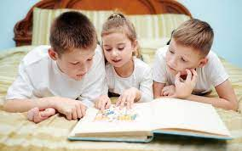
Questions to be asking when reading with your child
What is happening? Talk about what is happening in the pictures before you read the text. What can the children see? Who are the characters? What are they doing?
Discuss the setting of the story. Where is the story happening? Have you been to this setting before? Can you think of any other stories set in …..?
Make predictions. What do you think will happen next? What makes you think that? If their prediction is not very feasible, model your own using clues from the text

Slide 7
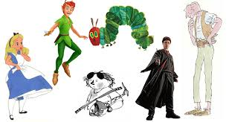
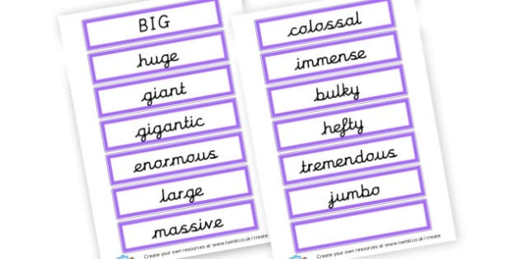
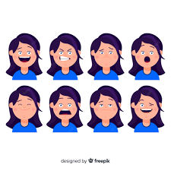
Questions to be asking when reading with your child
Discuss the characters? Who are they? Are they family? Can you think of any other stories who have the same characters? How are the characters feeling? Why might they feel like this?
Discuss unfamiliar words that appear in the text. What does the word mean? Which other word could have been used instead of ‘big’?
Turn to a page in the middle and look at the pictures, read the text. What do you think might have happened before this point? What might happen next?

