Slide 1
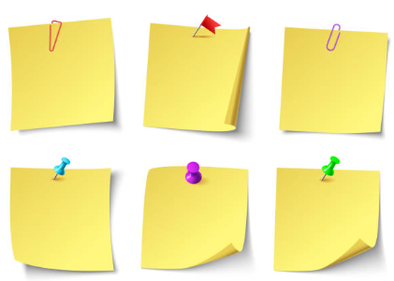
Can you read at least one book from the recommend reads list?
Tick them off on the list.
Can you visit the library and get the librarian to stamp this page?
Library Stamp -
Can you dress up as a book character and take a photograph?
Reading
Challenge
EYFS/KS1
2023
Can you read a book that has been turned into a movie?
Can you take a photograph of you reading in an unusual place?
Can you read a fiction and a non fiction book?
During the half term break try and complete all 6 tasks. Completed entries to be return to school by Tue 28th Feb to be in with a chance of winning a prize. Photographs can be added to OLSA Facebook page or sent to your class email.

Slide 2
Can you read at least one book from the recommend reads list?
Tick them off on the list.
Can you visit the library and get the librarian to stamp this page?
Library Stamp -
Can you write a book review about your favourite book?
Reading
Challenge
KS2
2023
Can you read a book that has been turned into a movie?
Can you take a photograph of you reading in an unusual place?
Can you read a fiction and a non fiction book?
During the half term break try and complete all 6 tasks. Completed entries to be return to school by Tue 28th Feb to be in with a chance of winning a prize. Photographs can be added to OLSA Facebook page or sent to your class email.

