Slide 1
Roman Catholic Diocese of Hexham and Newcastle
Our Lady & St. Anne’s
(OLSA)
Parents’ Information September 2020
Mission Statement
We want the best teaching, the best opportunities and the best support and encouragement for every child. We are a friendly, happy, Catholic school , where everyone is valued for their individuality and special gifts.
Motto
Our Light Shines Always (OLSA)

Slide 2
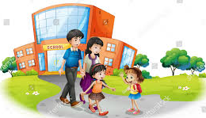
Roman Catholic Diocese of Hexham and Newcastle
Our Lady & St. Anne’s
(OLSA)
Parents’ Evening September 2020
Good Example
Please support us, as we try to educate your children in every way, by setting a good example with your conduct on the school yard and on the way to and from school. Please remember not to approach other parents if your children fall out, but to let school know so we can resolve any conflicts.
Many thanks

Slide 3
Roman Catholic Diocese of Hexham and Newcastle
Our Lady & St. Anne’s
(OLSA)
Parent hub
This is our means of communication with parents. It is very easy to use and all parents must upload the app to any smart phone or device.

Slide 4
Roman Catholic Diocese of Hexham and Newcastle
Our Lady & St. Anne’s
(OLSA)
Parent pay
We are a cashless school and all payments to school must be made via our parent pay online channel. Everyone has had a code to access. If there are any difficulties, please see Mrs Clennell.

Slide 5
Roman Catholic Diocese of Hexham and Newcastle
Our Lady & St. Anne’s
(OLSA)
Behaviour system
We use the “Good to be Green” system. Children are given two chances before being given a yellow card. Yellow and red cards (for poor behaviour) are logged and reported to you at the end of the year. Red and platinum cards trigger a parent hub message on the day they are given. Platinum cards are for outstanding behaviour.

Slide 6
Roman Catholic Diocese of Hexham and Newcastle
Our Lady & St. Anne’s
(OLSA)
Consent sheets
Please ensure that you have given school all the necessary consents.
Update new telephone numbers or address straight away.

Slide 7
Roman Catholic Diocese of Hexham and Newcastle
Our Lady & St. Anne’s
(OLSA)
Website
Please check our website www.olsa.org.uk regularly for all calendar events and information about your child e.g. via the class blogs.
Mr. O’Brien posts a weekly message and there is a wealth of information about the school.

Slide 8
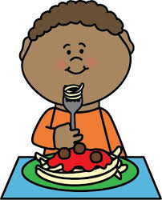
Roman Catholic Diocese of Hexham and Newcastle
Our Lady & St. Anne’s
(OLSA)
School Meals
All lunches are individually packed at the minute. We are currently offering hot packed lunches 3 days a week, with sandwich options on the other two.

Slide 9
Attendance
Attendance in school is vital for your child’s
education. We pride ourselves on attendance
improvements in recent years.
Please support us by sending your child to
school every day.

Slide 10
Punctuality
School times are staggered to ensure social distancing.
Please DO NOT come onto school grounds before your
time slot, unless your child has siblings.
EYFS – 9.10-2.45
School staff are required to be off site at 3.30
so the school can be deep cleaned each night.

Slide 11
Tapestry Journal
My Maths homework (Y1-Y6) is set weekly.
Children who have not completed their
Homework will do so at lunchtime on Friday.
In Year ? we do P.E. each whicheverday and
We go swimming each Tuesday. Only in
extreme circumstances will children be
Allowed to miss swimming.
Tapestry Learning Journal is an online system that records observations made in EYFS.
Please provide an email address so we can sign you up!
You must activate your login details by following the link sent to you via email.
We are aiming to have everyone on
by October half term.

Slide 12
How to connect to the Tapestry app.
Download the Tapestry app for free. It is available for smart and android devices. (Phone or tablet)
The next time you log in you will be asked to enter a PIN number. This will be quicker and more efficient when logging on.
Login using your email address and password.

Slide 13
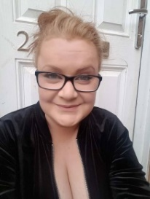
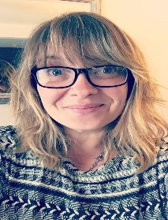
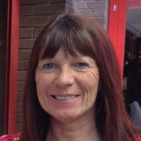
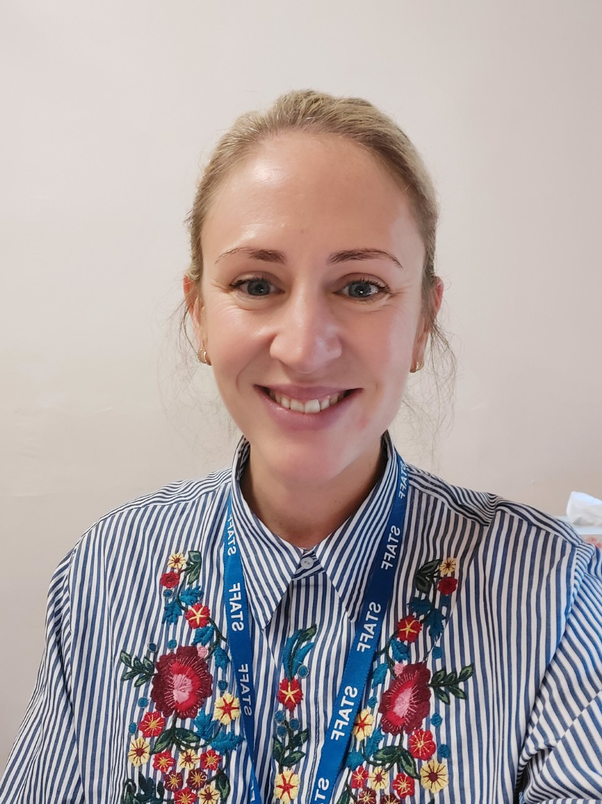
Meet the Staff
Mrs Milligan
EYFS Teacher
EYFS Lead
Miss Farrier
EYFS
Teaching Assistant
Miss Moor
EYFS
Teaching Assistant
Miss McAnespie
EYFS HLTA
Miss Mackell
EYFS
Teaching Assistant
Mrs Henzell
Deputy Headteacher

Slide 14
Our curriculum
Play based learning activities are planned from the children’s interests and create opportunities for development.
We use the Development Matters statements to assess the children. Personal, Social and Emotional Development, Communication and Language and Physical Development are prioritised.
Maths, Literacy, Expressive Art and Design and Understanding the World follow once the prime areas are established.
We use a mixture of outdoor and indoor play
Messy play is an essential part of curriculum

Slide 15
Early Years Information
In Early Years, we focus on child initiated learning.
We choose topics based on the children’s interests
or seasonal celebrations throughout the year. We
use books as a stimulus for learning, planning cross
curricular activities which reinforce the story. We
use Talk4Writing techniques to help with story
recognition and retell.

Slide 16
Reception Information
*On Thursdays we have a Music session with Mr
Miller.
*Homework activities will be sent home on a Friday.
Please complete these and add an observation on
to Tapestry. Paper copies remain at home due to
COVID regulations.
We also encourage the regular use of Reading Eggs.

Slide 17
Our Curriculum - Phonics
We use the Read Write Inc scheme in school to teach
daily phonics . Children learn the English alphabetic code:
first they learn one way to read the 40+ sounds and blend
these sounds into words, then they learn to read the same
sounds with alternative graphemes. Once the children are
confident with a range of sounds, they use these to practise
Writing, first rehearsing out loud what they want to say, before
spelling the words using the graphemes and ‘tricky’ words they
know.
There are lots of videos on YouTube which will support the
teaching of RWI at home, including parent introductions and daily
phonic lessons.

Slide 18
Our Curriculum - Maths
In Reception, Maths is taught in a practical way, as the children get to
grips with the ideas of numbers and calculations. Children will be working
with numbers every day, in a range of different ways. They will be using
familiar objects to help them learn about how numbers are used in everyday
life, and they will also be linking numbers to topic work; for example, if they
are learning about dinosaurs they could be making dinosaur pictures out of
shapes. They will be encouraged to be curious and explore numbers. They
will be playing number games, singing counting songs, making models and
using the role-play area, as well as being introduced to the ideas of addition
and subtraction. At home, try to talk about numbers and shapes– it’s
important for children to see just how much Maths is used in everyday life.
We also love Numberblocks in Reception; they are fantastic way of
developing mathematical thinking.

Slide 19
Nursery Information
A standard Nursery day is focused around play based learning.
We set up and create opportunities for development in all areas
of the Early Years Curriculum.
This year, your child will begin to learn by doing things for
themselves, by exploring and investigating, watching and listening,
talking and discussing, creating and communicating – in other
words, playing. Play is children’s work and playing hard is very
tiring! Play can also be very messy as your child will be learning
both inside with sand, water and paint, and also in the outdoors
with mud, leaves and so on, so you can expect some mucky clothes
at the end of the day!

Slide 20
Nursery Information
Once the children has developed a solid foundation in the prime
areas of learning, we begin to introduce the 4 specific areas of
learning into their everyday play. These areas are Literacy,
Maths, Understanding the World and Art and Design. This is
delivered in the same way as the prime areas, following a play
based learning approach.
Maths – We will be using the very successful Numberblocks
program to embed the understanding of numbers 1 -10 and shape,
space and measure.
Phonics – Before we can begin this in Nursery, the children need to
develop a good understanding of how vocabulary works, utilising their
speaking skills and learning to listen carefully.

Slide 21
EYFS – Things to Remember.
Please make sure you child has several spare sets of clothes in
Nursery; these will stay in school.
In Reception, children should have a spare set of clothes that will
stay on their peg.
Please ensure your child has a water bottle in school; this
should be kept in school all week and taken home every Friday for
deep cleaning.
Please ensure your child wears suitable clothing to promote
independence when using the toilet.
Please encourage your child to put on and remove their own
coat; again, this promotes independence.

Slide 22
EYFS – Covid Safety.
In EYFS, staff will often need to speak to you regarding your child. To ensure the safety of both staff and parents, please make sure you have a face mask or covering readily available.
Please do not come to the Nursery Door as staff can not follow social distancing rules safely if you do so. Again, this is to protect staff and parents.
Children are required to wash their hands as they arrive and we have set times throughout the day for handwashing. This is in addition to regular times, before snack time and lunch time.
Please do not allow your child to bring anything into school e.g. toys, books or food items other than packed lunch.

