Slide 1
Ready for Year 1
How you can help your Reception child work towards the Early Learning Goals and prepare your child for the transition into Year 1 in September.

Slide 2
What are the Early Learning Goals?
The Early Learning Goals (ELGs) establish expectations for children's learning and development by the end of the Early Years Foundation Stage. There are 17 Early Learning Goals across the 7 areas of the Early Years curriculum. The 17 targets are benchmarks which your child is aiming to achieve by the end of Reception class. Day-to-day informal checking of what children have learnt will inform teaching and learning on an ongoing basis throughout the Reception class.
The EYFS profile recognises and values linguistic diversity and is inclusive of children whose home language is not English. However, the ELGs for communication and language, and for literacy, must be assessed in relation to the child’s competency in English.

Slide 3
Personal, Social and Emotional Development (PSED)

Slide 4
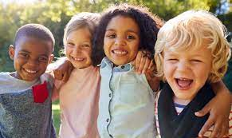
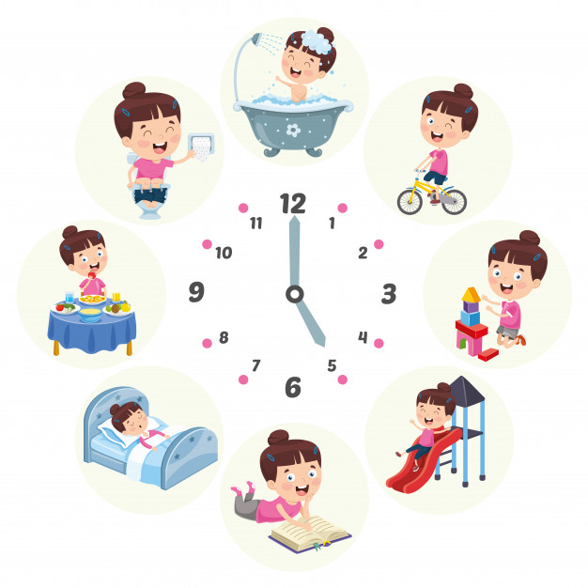

Slide 5
Communication and Language (C&L)

Slide 6
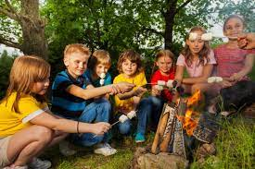
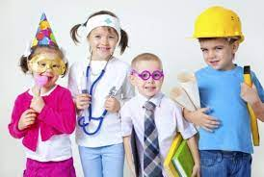
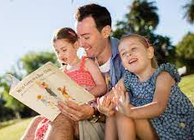

Slide 7
Physical Development

Slide 8
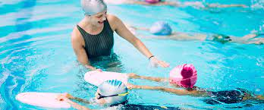
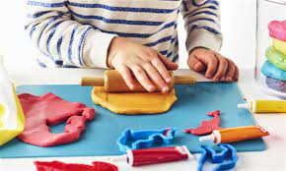
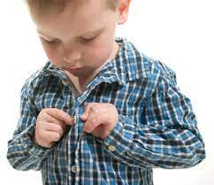
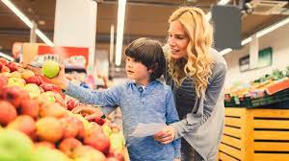

Slide 9
Literacy

Slide 10
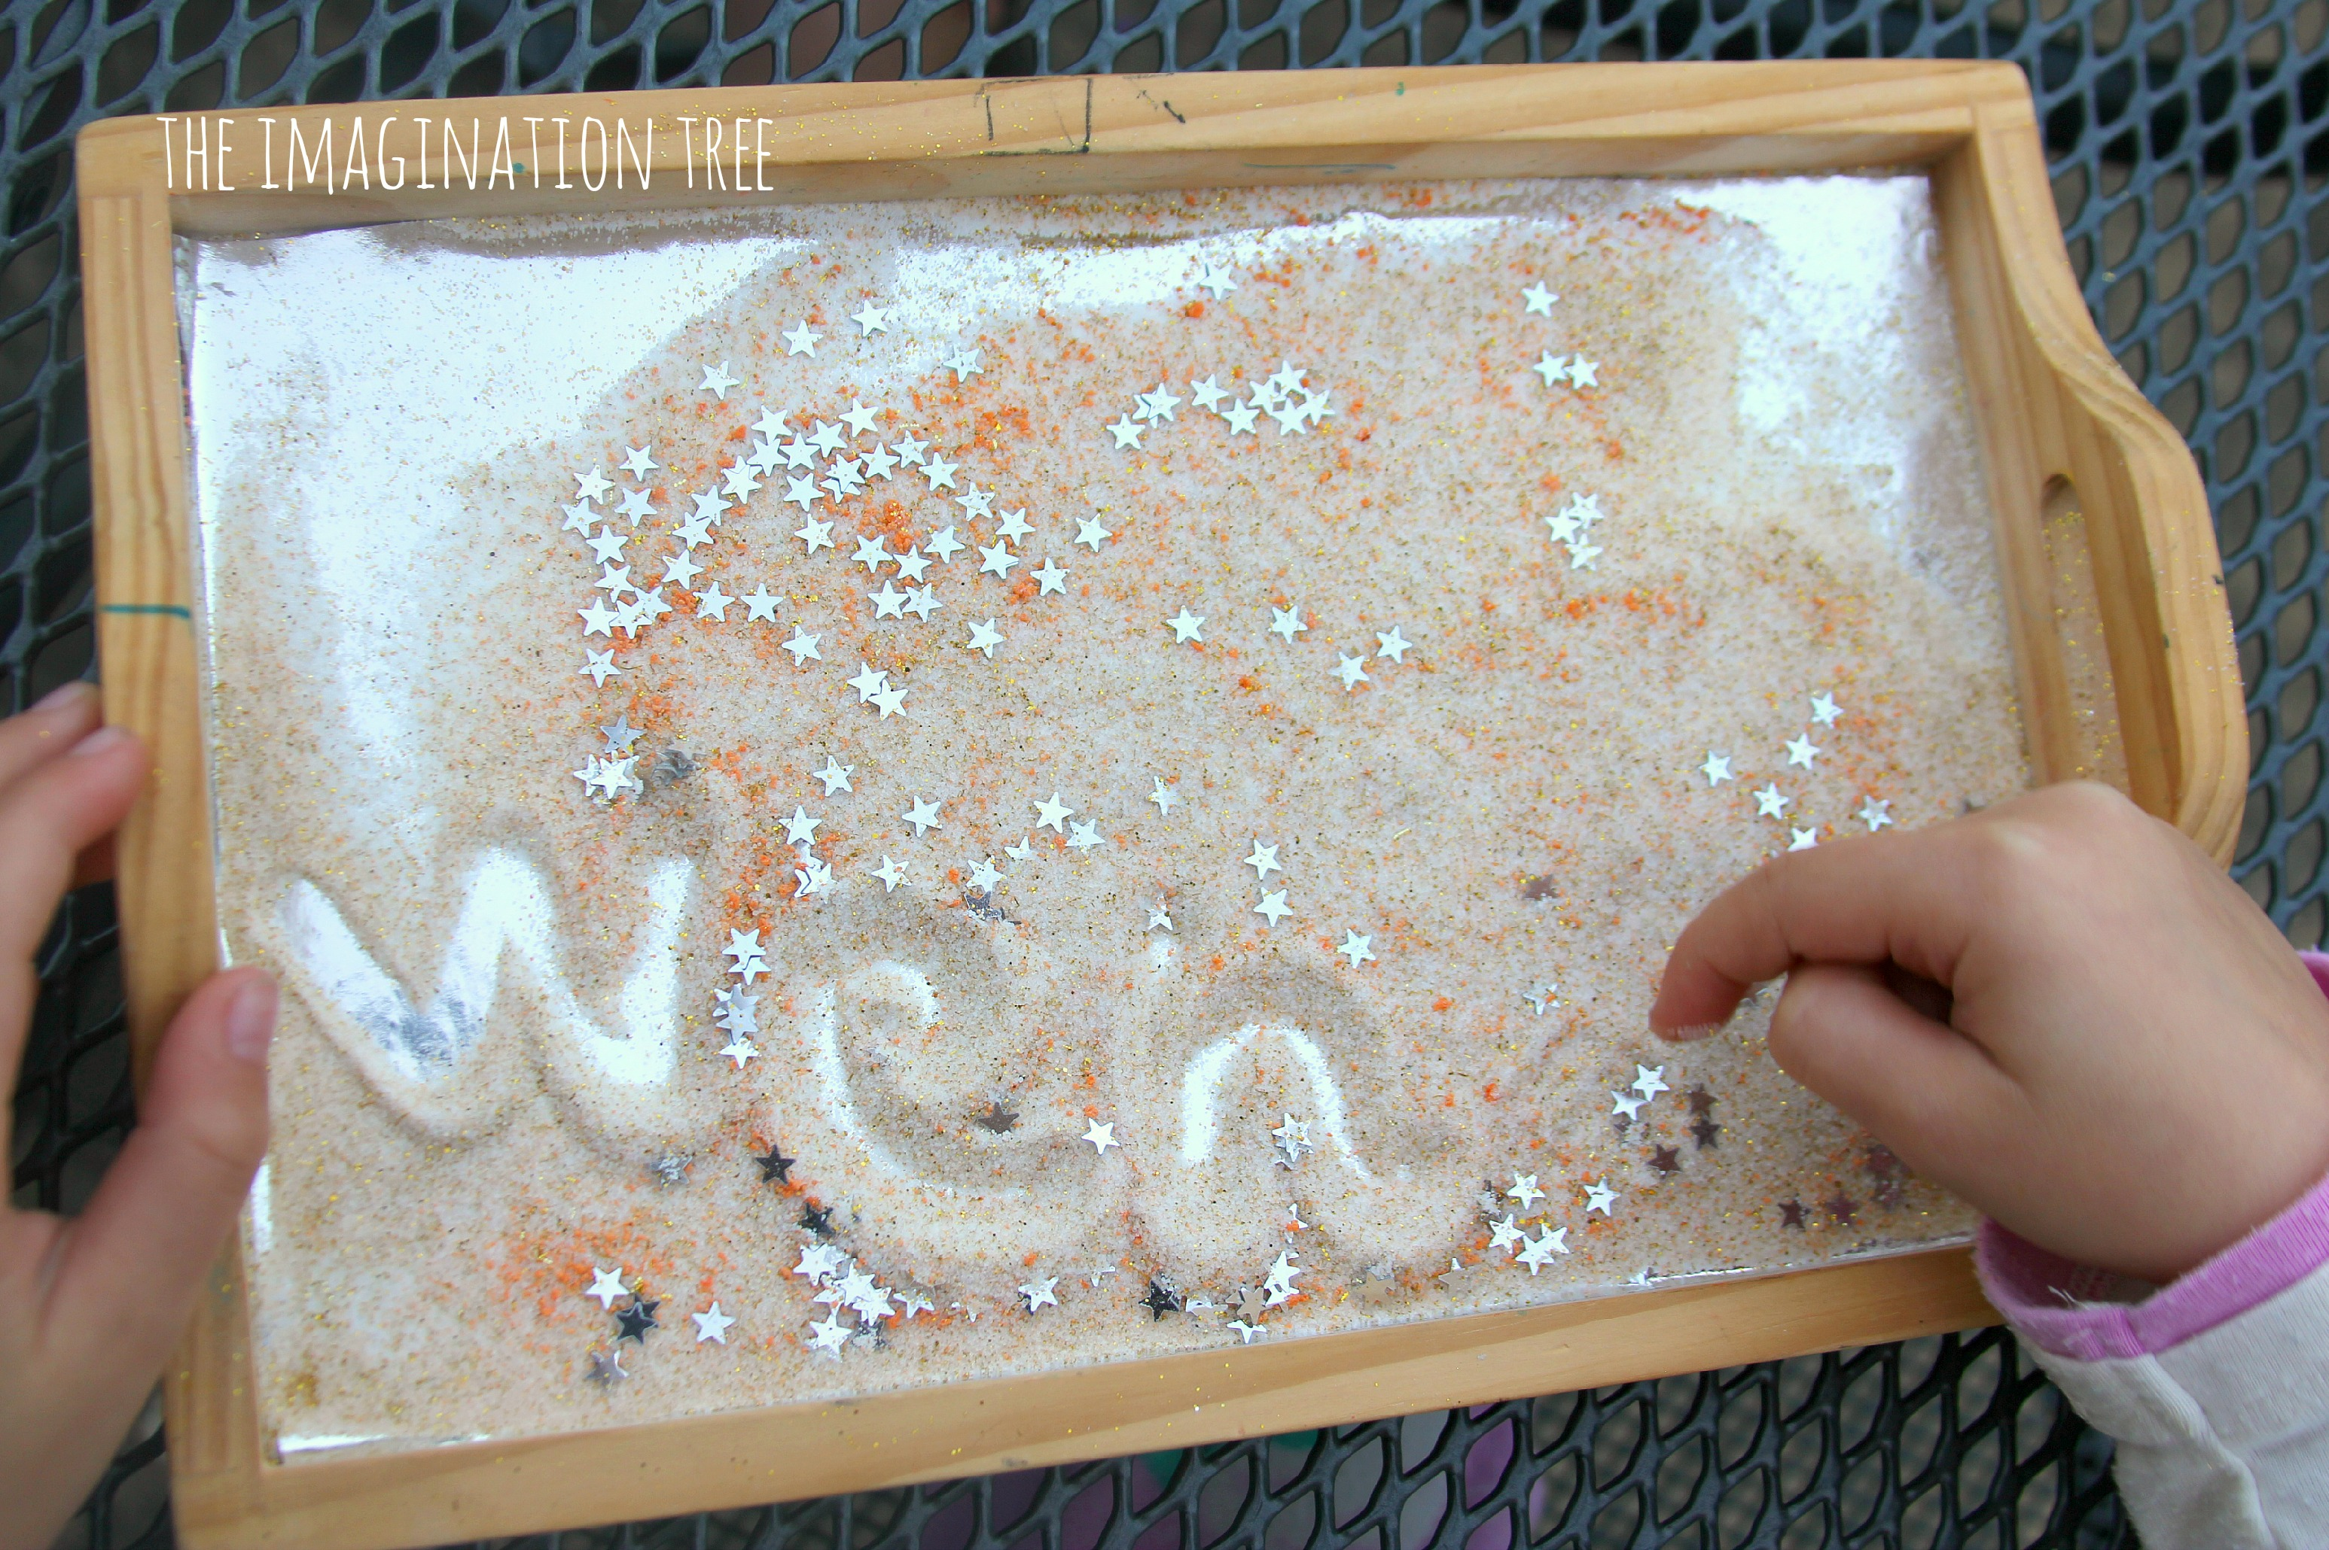
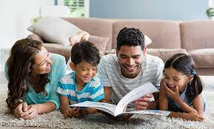
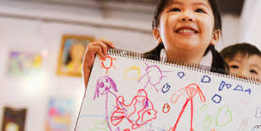
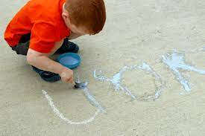
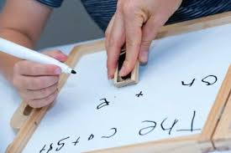

Slide 11
This is the expected level of a child reaching the early learning goal for writing.

Slide 12
This is the expected level of a child reaching the early learning goal for Reading.

Slide 13
Mathematics

Slide 14
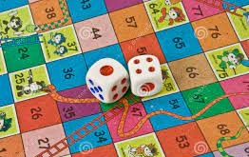
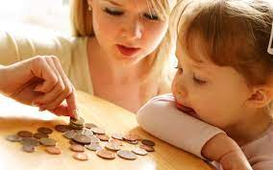
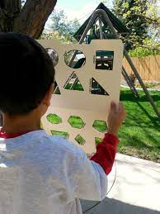
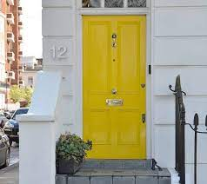
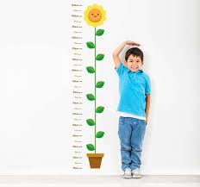
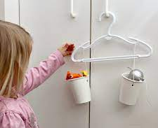

Slide 15
These are examples of number evidence for an expected child.

Slide 16
Understanding the World

Slide 17
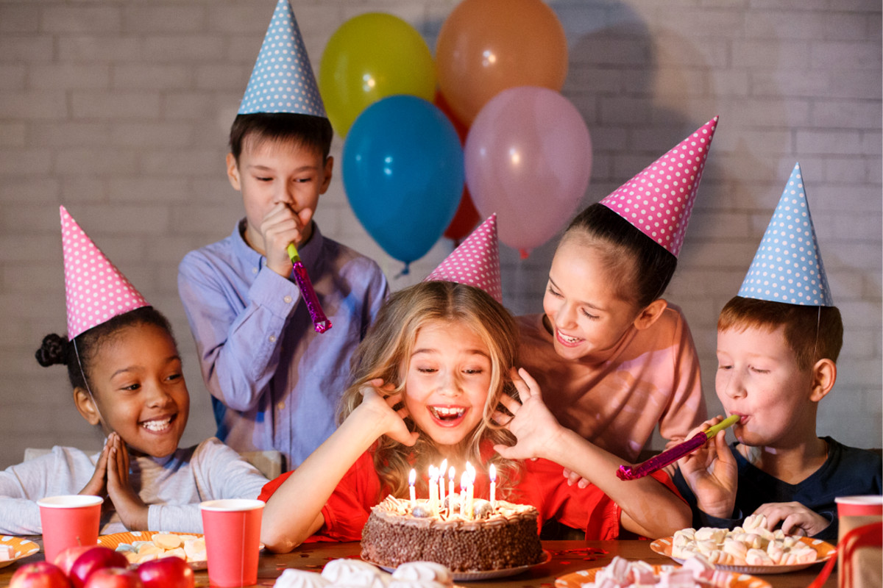
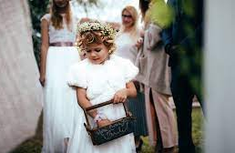
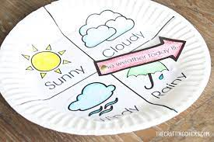
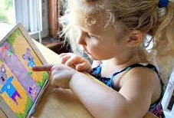
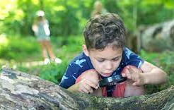

Slide 18
Expressive Arts and Design

Slide 19
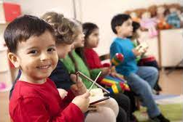
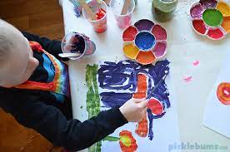
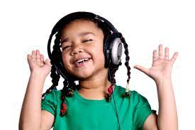
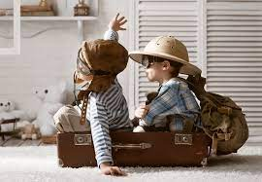
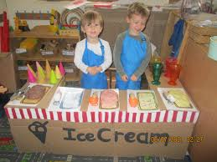

Slide 20
Summer Term
The EYFS Profile summarises and describes children’s attainment at the end of the EYFS. It is based on on-going observation and assessment in the three prime and four specific areas of learning, and the three learning characteristics,
• playing and exploring
• active learning
• creating and thinking critically.
All of the observations and teacher knowledge of the children will influence the decision as to whether they are at the expected level of development. If a child is not at the expected level of development they will receive an emerging judgement.

Slide 21
Why assess the children using the ELGs?
The primary uses of EYFS Profile data are as follows.
• To inform parents about their child’s development against the ELGs and the characteristics of their learning.
• To support a smooth transition to Key Stage 1 by informing the professional dialogue between EYFS and Key Stage 1 teachers.
• To help Year 1 teachers plan an effective, responsive and appropriate curriculum that will meet the needs of all children.
To provide a baseline assessment which can be used to track the progress and development of your children throughout their primary education.

Slide 22
Main targets for the children
Give focused attention to what the teacher says, responding appropriately even when engaged in activity, and show an ability to follow instructions involving several ideas or actions.
Be confident to try new activities and show independence, resilience and perseverance in the face of challenge.
To be able to count and recognise numerals to 20.
To explore and represent patterns within numbers up to 10, including evens and odds, double facts and how quantities can be distributed equally.
To be able to apply sounds learnt in phonics to write in sentences.
Read aloud simple sentences and books that are consistent with their phonic knowledge, including some common exception words.
To express their ideas and feelings about their experiences using full sentences, including use of past, present and future tenses and making use of conjunction, with modelling and support from their teacher/parents.
To show independence with undressing and dressing themselves.

Slide 23
Thanks so much for your support Mrs Milligan

