Slide 1


Roman Catholic Diocese of Hexham and Newcastle
Our Lady & St. Anne’s
(OLSA)
Year 2 Parents’ Information
September 2020
Mission Statement
We want the best teaching, the best opportunities and the best support and encouragement for every child. We are a friendly, happy, Catholic school , where everyone is valued for their individuality and special gifts.
Motto
Our Light Shines Always (OLSA)

Slide 2
Roman Catholic Diocese of Hexham and Newcastle
Our Lady & St. Anne’s
(OLSA)
Welcome to Year 2
We are so excited to be welcoming your children into our classroom.
These are the names of your child’s teachers this year.
Miss Justice Miss Seddon
Mr Ramsey Mr Emson

Slide 3


Roman Catholic Diocese of Hexham and Newcastle
Our Lady & St. Anne’s
(OLSA)
Parent hub
This is our main method of communication with parents. It is very easy to use please download the app to any smart phone or device.

Slide 4

Roman Catholic Diocese of Hexham and Newcastle
Our Lady & St. Anne’s
(OLSA)
Keep in Touch!
Year 2 have their very own email address!
y2@olsa.org.uk
Any questions and queries are always welcome.

Slide 5

Y2 PE Day
The children in Year 2 will have a PE lesson on Friday.
This means that they come to school in their PE Kit.
Unfortunately we are not able to get changed at school.
PE Kit
White t-shirt with school logo
Navy shorts
Black plimsoles or trainers
(black or navy tracksuit for outdoor PE)
My Maths homework (Y1-Y6) is set weekly.
Children who have not completed their
Homework will do so at lunchtime on Friday.
In Year ? we do P.E. each whicheverday and
We go swimming each Tuesday. Only in
extreme circumstances will children be
Allowed to miss swimming.

Slide 6

Reading
My Maths homework (Y1-Y6) is set weekly.
Children who have not completed their
Homework will do so at lunchtime on Friday.
In Year ? we do P.E. each whicheverday and
We go swimming each Tuesday. Only in
extreme circumstances will children be
Allowed to miss swimming.
In Year 2 we encourage a love of reading both at
home and at school.
Every child will have a school reading book and
library book available to read within school.
Please encourage your child to read at home too.
Enjoy a story together and listen to them read too.

Slide 7

Y2 Home Learning
My Maths homework (Y1-Y6) is set weekly.
Children who have not completed their
Homework will do so at lunchtime on Friday.
In Year ? we do P.E. each whicheverday and
We go swimming each Tuesday. Only in
extreme circumstances will children be
Allowed to miss swimming.
While we are unable to send reading books home,
you can still access Oxford Reading Owls, which has
a great range of stories and non fiction texts, for
your child to read at home.
Username: olsay2
Password: Books

Slide 8


Y2 Home Learning
My Maths homework (Y1-Y6) is set weekly.
Children who have not completed their
Homework will do so at lunchtime on Friday.
In Year ? we do P.E. each whicheverday and
We go swimming each Tuesday. Only in
extreme circumstances will children be
Allowed to miss swimming.
My Maths and Reading Eggs tasks are set weekly.
Please complete these tasks by Thursday.
Pop us an email if you need a password reminder.
y2@olsa.org.uk

Slide 9
Y2 Phonics Check
My Maths homework (Y1-Y6) is set weekly.
Children who have not completed their
Homework will do so at lunchtime on Friday.
In Year ? we do P.E. each whicheverday and
We go swimming each Tuesday. Only in
extreme circumstances will children be
Allowed to miss swimming.
Due to school being closed in Summer Term 2019
Y2 will be completing a phonics check at the end of
Autumn Term.
So please make sure your child is regularly accessing
Reading eggs and Oxford Reading Owls.
Visit the Phonics made easy page for further hints,
tips and videos to help you learn more about
phonics and how you can help your child in the
most effective way.

Slide 10

Y2 Home Learning
My Maths homework (Y1-Y6) is set weekly.
Children who have not completed their
Homework will do so at lunchtime on Friday.
In Year ? we do P.E. each whicheverday and
We go swimming each Tuesday. Only in
extreme circumstances will children be
Allowed to miss swimming.
Year 2 can also still access Charanga Music
at home too!
Username: olsayear2
Password: olsa2020

Slide 11

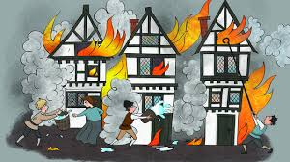


Y2: What will we be learning?
My Maths homework (Y1-Y6) is set weekly.
Children who have not completed their
Homework will do so at lunchtime on Friday.
In Year ? we do P.E. each whicheverday and
We go swimming each Tuesday. Only in
extreme circumstances will children be
Allowed to miss swimming.
Autumn Term
Traditional Tales The Great Fire of London
Our World The Creation Story

Slide 12


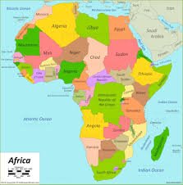

Y2: What will we be learning?
My Maths homework (Y1-Y6) is set weekly.
Children who have not completed their
Homework will do so at lunchtime on Friday.
In Year ? we do P.E. each whicheverday and
We go swimming each Tuesday. Only in
extreme circumstances will children be
Allowed to miss swimming.
Spring Term
Materials Titanic
Africa The Easter Story

Slide 13

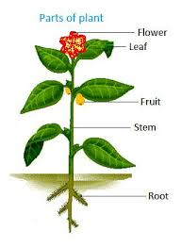
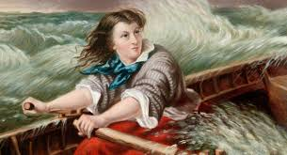
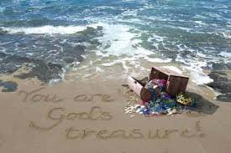
Y2: What will we be learning?
My Maths homework (Y1-Y6) is set weekly.
Children who have not completed their
Homework will do so at lunchtime on Friday.
In Year ? we do P.E. each whicheverday and
We go swimming each Tuesday. Only in
extreme circumstances will children be
Allowed to miss swimming.
Summer Term
Island Life Plants
Grace Darling God’s Treasures

Slide 14



Roman Catholic Diocese of Hexham and Newcastle
Our Lady & St. Anne’s
(OLSA)
Behaviour system
We use the “Good to be Green” system. Yellow and red cards (for poor behaviour) are logged and reported to you at the end of the year. Red and platinum cards trigger a parent hub message on the day they are given. Platinum cards are for outstanding behaviour.

Slide 15


Roman Catholic Diocese of Hexham and Newcastle
Our Lady & St. Anne’s
(OLSA)
Parent pay
We are a cashless school and all payments to school must be made via our parent pay online channel. Everyone has had a code to access. If there are any difficulties, please see Mrs Clennell.

Slide 16
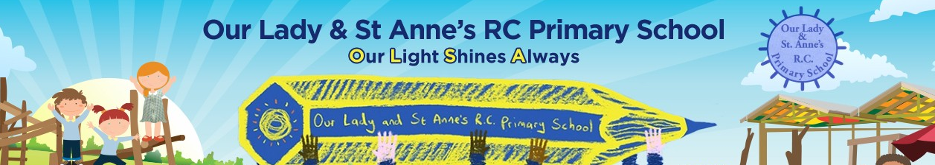
Roman Catholic Diocese of Hexham and Newcastle
Our Lady & St. Anne’s
(OLSA)
Website
Please check our website www.olsa.org.uk regularly for all calendar events and information about your child e.g. via the class blogs.
Mr. O’Brien posts a weekly message and there is a wealth of information about the school.

