Slide 1


Year 3

Slide 2


Roman Catholic Diocese of Hexham and Newcastle
Our Lady & St. Anne’s
(OLSA)
Year 3 Parents’ Information
September 2020
Mission Statement
We want the best teaching, the best opportunities and the best support and encouragement for every child. We are a friendly, happy, Catholic school , where everyone is valued for their individuality and special gifts.
Motto
Our Light Shines Always (OLSA)

Slide 3



Roman Catholic Diocese of Hexham and Newcastle
Behaviour system
We use the “Good to be Green” system. Yellow and red cards (for poor behaviour) are logged and reported to you at the end of the year. Red and platinum cards trigger a parent hub message on the day they are given. Platinum cards are for outstanding behaviour.

Slide 4

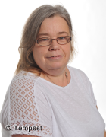
Class Staff
Miss Hodgson Ms Donnelly
Notes:
CS

Slide 5
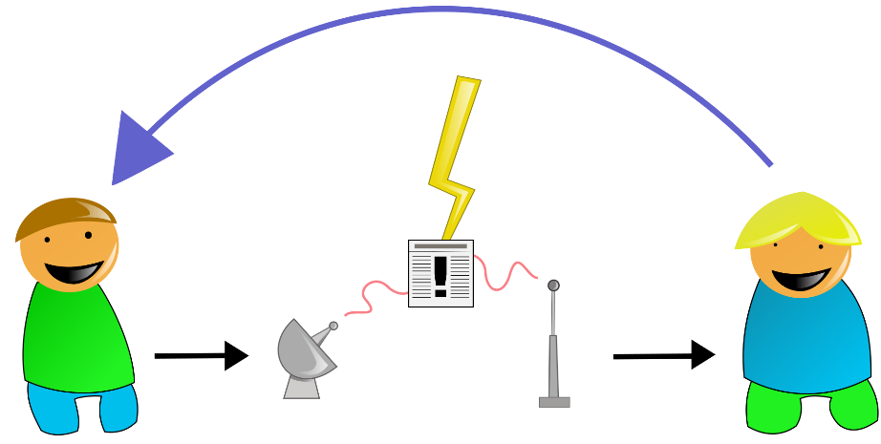


Information
Unfortunately, in the current circumstances, staff are unable to talk in length with parents at the school gate.
Should you wish to discuss anything with your child’s class teacher, please do so via a phone call or email:
yr3@olsa.org.uk
Notes:
EB

Slide 6

Parent Hub
Our main form of communication with parents is through Parent Hub, so please ensure that you have the app downloaded and that you check it regularly.
We share information regarding whole school and individual classes, so it is essential that we have this means of communication.
Notes:
EB

Slide 7
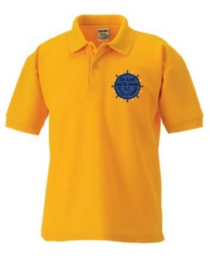
Uniform
Correct school uniform should be worn at all times.
Black school shoes should be worn rather than trainers unless on a PE day.
Uniform should be labelled clearly.
Jewellery is not allowed in school.
Make-up, including nail varnish, is not allowed in school.
Children are encouraged to bring in a water bottle to have during lessons but this MUST contain water and not juice.
Notes:
LM

Slide 8

PE Kit
Children should arrive in their PE kits on their designated day and do not need to bring a change of clothes. They may wear black or navy jogging bottoms as it is getting colder. Trainers are acceptable footwear.
Year 3 have P.E. on Thursday.
This term Year 3 are concentrating on basketball.
Notes:
CS

Slide 9
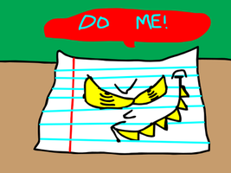

Homework
Homework will be set on Friday. It will comprise of a piece of work on Mymaths and some work set on Reading Eggs.
Both of these need to be completed by the following Tuesday.
In addition to this spellings will be set once a week.
These may be found on the Year 3 parent hub on Thursday afternoon.
They need to be practised and learnt for the following week’s test.
This Photo by Unknown Author is licensed under CC BY-NC

Slide 10
Curriculum Map 2020-2021
 | Autumn |  |  | Spring |  |  | Summer
English - writing | Fiction with a familiar setting and a problem to solve Poetry – free verse and word play | Fiction – Stories with a historical setting Non-fiction – Non-Chronological Reports - Stone Age and Prehistoric Animals | Fiction – Mystery Stories – The Black Rock Non- fiction – Recount Texts | Fiction – Mystery Stories – The Black Rock Non- fiction – Recount Texts | Non- fiction – Persuasive Texts – letter writing (Traditional Tales) Instructions Poetry – Michael Rosen | Non- fiction – Persuasive Texts – letter writing (Traditional Tales) Instructions Poetry – Michael Rosen | Fiction: – Adventure Stories - Development of Plot – Flat Stanley and Books by Anthony Browne Non-fiction: – Explanation Texts | Fiction: – Stories from factual Events Non-fiction: – Explanation Texts –
SPaG | Weekly spelling tests focusing on spelling rules and Year 3/4 words
 | Revision of Year 2 Word groups- nouns, verbs, adjectives and adverbs Use of the forms of a and an | Use of inverted commas Word groups- conjunctions, and pronouns Prefixes and Suffixes:- er, est, | Verb tenses – irregular verbs Apostrophes for omission Prefixes – un, dis, re, pre, mis, anti, co |  | Sentence types and expansion – clauses/phrases Homophones |  | Apostrophes for single possession Pronoun use. Homophones and near homophones | Consolidation of Year 3 SPaG content
Reading | Using pictures to make inferences Poetry – for pleasure Traditional Folk Tales | Non-fiction texts about Stone Age Class Novel – Little Nose | Stories from the bible Class Novel – The Black Queen |  | Traditional tales and twisted versions |  | Egyptian Myths | Stories from other cultures – The Islamic World, Jewish Stories
Maths | See attached Maths plan Weekly Maths skills checks Weekly times table checks
Science | Animals and humans |  | Rocks |  | Plants |  | Forces/Magnets | Light

Slide 11
 | Autumn |  |  |  | Spring |  |  |  | Summer
RE | Homes- God’s Dream for Every Family | Promises - Baptism | Judaism | Visitors:- Advent and the coming | Journeys:- Christian’s family’s journey with Jesus | Listening & Sharing:- The Eucharist |  | Giving All:- Lent | Energy:- Gifts of the Holy Spirit | Choices:- Sacrament of Reconcil-iation | Special Places: - Holy Places for Jesus & Christians |  | Islam:- The Mosque
PE | Basic Skills & Basketball |  | Dance |  | Gymnastics |  | Basic Skills |  | Cricket |  | Athletics | Athletics
History |  |  | Changes in Britain – Stone Age |  |  |  | Changes in Britain – The Iron Age |  |  |  | Ancienet Egypt | Ancienet Egypt
Geography | Our place in the world and settlement |  |  |  | Water and the Water Cycle |  |  |  | Coasts
Art | Sketching- use of lines, cross hatching in drawing |  | Early Art – Cave Painting – using natural materials paints |  |  |  |  |  | Water in Art - Katsushika Hokusai - The Great Wave off Kanagawa, Claude Monet – The Water Lillies, Van, Escher – Reflection and Puddle
DT |  |  | Healthy Diet - Food groups and cooking |  | Designing and Making fossils |  |  |  |  |  | Egyptian Technology – Shadufs and Pyramids | Egyptian Technology – Shadufs and Pyramids
Computing | Word Processing – combining text and graphics – Book creator, Coding and Debugging, Using the internet for research, E-Safety,
MFL | French
Music | Music Appreciation- Classic works – Peter and the Wolf, |  |  |  | Penny Whistles |  |  |  |  |  |  | Charanga

Slide 12



Mathematics
MyMaths – A weekly learning activity will be released on a Friday for completion on the following Tuesday.
Abacus- A range of games are available to embed previously learned concepts and strategies with a fun and engaging interface.
Times Tables Rock Stars- An interactive multiplication game designed to encourage children to develop a rapid recall of multiplication tables.
By the end of year 3 children are expected to be able to recall multiplication and division facts for multiplication tables 2, 5, 10, 3 , 4 and 8.

Slide 13
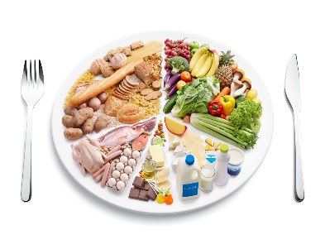
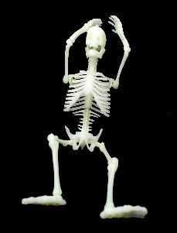
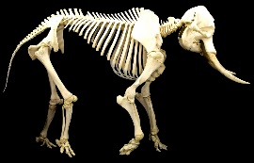
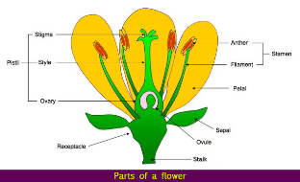
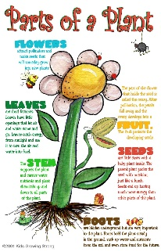
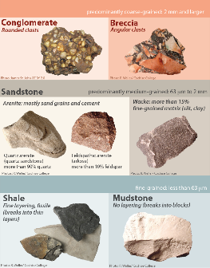

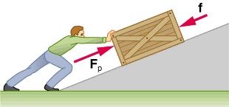

Topics
Over the upcoming year we are planning to cover the following topics in science:
Animals including Humans
Plants Rocks
Light
Forces and Magnets
Notes:
ML and LW

Slide 14

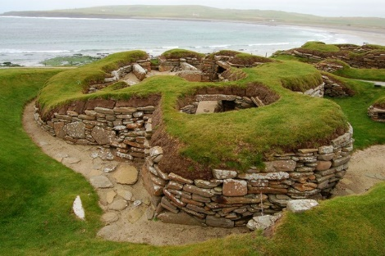
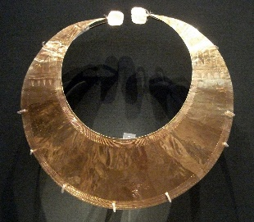
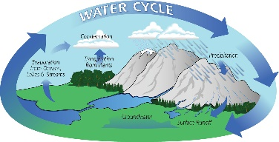
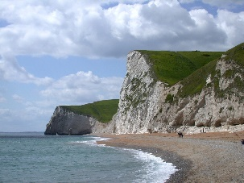
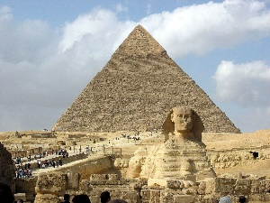
Topics
Over the upcoming year we are planning to cover the following Geography topics:
Map Skills – Our Place in the
World & Settlement
Water and the Water Cycle
Coasts
Over the upcoming year we are planning to cover the following History topics:
Stone-age
Bronze Age to Iron Age
The Ancient Egyptians
Notes:
ML and LW

Slide 15
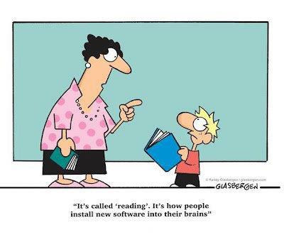


Reading
Children should be reading daily at home and at school.
Although we can not currently send reading books home, the children all have access to Reading Eggs and Lexia. Both of these programs are excellent at supporting the children.
Notes:
EB

Slide 16

Y3 Home Learning
My Maths homework (Y1-Y6) is set weekly.
Children who have not completed their
Homework will do so at lunchtime on Friday.
In Year ? we do P.E. each whicheverday and
We go swimming each Tuesday. Only in
extreme circumstances will children be
Allowed to miss swimming.
While we are unable to send reading books home,
you can still access Oxford Reading Owls, which has
a great range of stories and non fiction texts for
your child to read at home.
Username: olsay3
Password: Books

Slide 17

Y3 Home Learning
Year 3 can also still access Charanga Music
at home too!
Username: olsayear3
Password: olsa2020

