Slide 1
Year One Back to School Meeting

Slide 2
Mission Statement
We want the best teaching, the best opportunities and the best support and encouragement for every child. We are a friendly, happy, Catholic school , where everyone is valued for their individuality and special gifts.
Motto
Our Light Shines Always (OLSA)

Slide 3
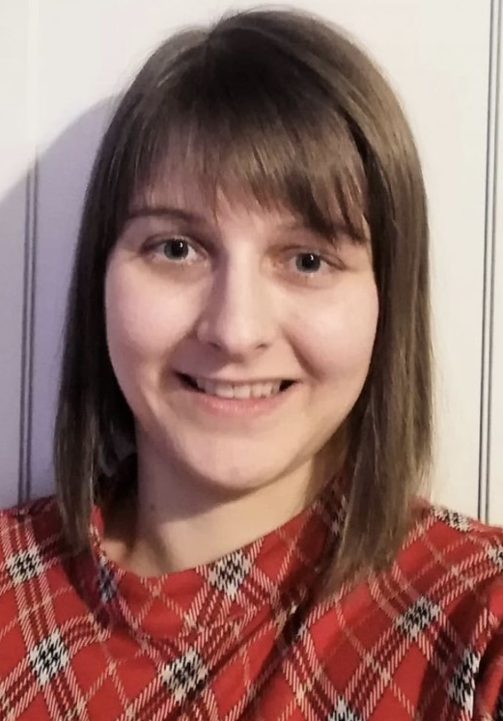
Class Teachers
Miss Wood
Class Teacher
Miss Quinn
Teaching Assistant

Slide 4
Transition from Reception to Year One
For the first half term, we will be working on the EYFS curriculum and completing assessments to address any curriculum gaps. I will be assessing the children on the early learning goals which are normally completed at the end of Reception.
The focus for the first half term is going to be settling the children back into school and supporting their emotional needs.

Slide 5
Curriculum Map

Slide 6
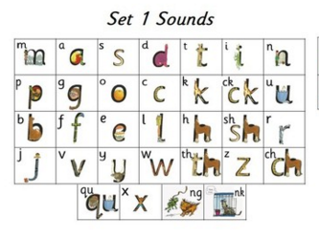
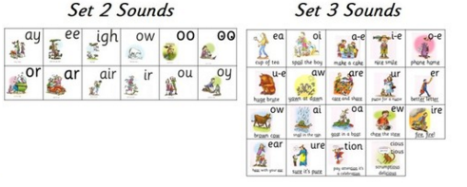
Phonics
In our school, we follow the Read, Write Inc scheme of phonics teaching. Each child in EYFS and Key Stage 1 has a daily Phonics lesson. In these phonics sessions, children access a balance of both Phonics and Spelling, Punctuation and Grammar (SPaG) lessons based on their individual needs and attainment.
At the end of Year 1 children have to take the National Phonics Test which tests children’s phonetic knowledge. Here, they are required to read real and nonsense words, applying the skills they have learned in their phonics lessons.

Slide 7
English
As a school, we teach English through Talk for Writing. A key feature is that children internalise the language structures needed to write through ‘talking the text’, as well as close reading. The book that we are currently reading is ‘Goldilocks and the three bears’.

Slide 8
Reading
The children should be reading with an adult at home on a daily basis. I would encourage parents to ask the children questions about what they have read to improve their comprehension skills.
As a school, we are encouraging the children to use Reading Eggs and I will be monitoring their progress over the year. It has been great to see some of the children are already accessing the resources.
Miss Quinn and I will be listening to 1-1 readers on a daily basis and small groups in guided reading.

Slide 9
Reading at home
Here are some questions that you might want to ask your child when they are reading.
Can you find the title and author?
What do you think will happen next?
What can you tell me about the story so far?
Can you predict how the story will end?
Can you put what you’ve just read in your own words?

Slide 10
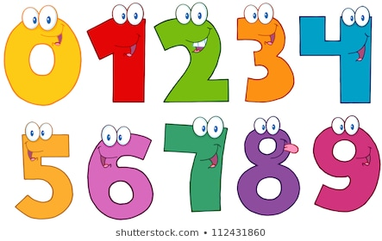
Maths
As a school, we follow the Abacus maths programme which you can find on our school website.
Times Tables – The children will have access to Times Tables Rocks Stars after October half term. More information will be sent out about this nearer the time. The children will need to learn their 2,5 and 10 times tables over the year.

Slide 11
P.E.
The children will have weekly P.E. lessons on a Wednesday. They will need to come into school wearing the school P.E. kit and trainers/sandshoes.

Slide 12
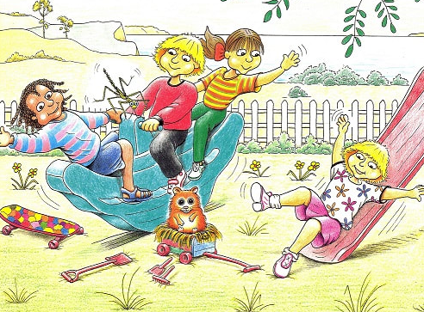
Zippy’s Friends
Zippys Friends is a social emotional programme that supports the children to better understand their emotions. Children develop their own positive strategies to deal with problems through engaging activities; listening to stories, discussion, games, role-play and drawing.

Slide 13
Forest School
The children will be doing forest school activities every Friday and will need to remember to bring wellies into school. Forest school allows the children to explore nature and the outdoors.

Slide 14
Class Rules
To sit quietly and smartly on the carpet.
To be kind and share.
Listen to each other.
To tidy our classroom
Put your hand up quietly when you would like to talk.
Line up smartly when moving around school.

Slide 15
Behaviour System
We use the “Good to be Green” system. Yellow and red cards are logged and reported to you at the end of the year. Red and platinum cards trigger a parent hub message on the day they are given.

Slide 16
Homework
MyMaths homework will be set every Friday to be completed by the following Thursday.
The children will be have access to Times Table Rockstars from October half term.
Children should be reading with an adult on a daily basis at home.

Slide 17
Contact Information
Unfortunately in the current circumstances, staff are unable to talk in length with parents at the gates.
If you do need to speak to me then please send an email to our class email account –
yr1@olsa.org.uk
Please remember to check the class blog which will be updated on a weekly basis.
We will be continuing to use Tapestry for the first half term as a way of updating you on your child’s progress.
Parent Hub is our means of communication with parents. It is very easy to use and all parents must upload the app to any smart phone or device.

